Slide 1
About Me
Currently a Helpdesk Analyst for Beacon Health System for almost 3 years.
Been programming for about 4-1/2 years
Come from a C++\Python background.
Motto: If you have to do it more than once write a script.

Slide 2
To Blend Or Not To Blend…?
Blending your apps for a fun and more animated look.
Notes:
Show of hands how many have used Blend before? How many even know Blend exists?

Slide 3
What Is Visual Studio Blend?
Blend is a WYSIWYG UI designer for WPF, Silverlight 1.0/2.0 Websites, Window’s 8.1 Store, and Windows Phone Apps.
Design applications with XAML or HTML (Windows 8.1 Apps).
Blend allows designers to focus on creativity and developers to focus on programming.
Notes:
Other Blend project supported languages and markup include; C++, C#, Visual Basic, JavaScript

Slide 4
Why Use Blend?
Animations and custom controls often require familiarity with complex concepts and extensive coding.
VS does not support Adobe artwork.
Edit Controls, templates, and styles.
Connect your IU to data.
Notes:
Import photoshop or illustrator artwork and implement the UI in Blend
VS you can create a data source from resources such as SQL DB, sharepoint lists, and web services then bind the data to your IU Controls
In Blend you create sample data for prototyping on the fly. Auto generates data for you.

Slide 5
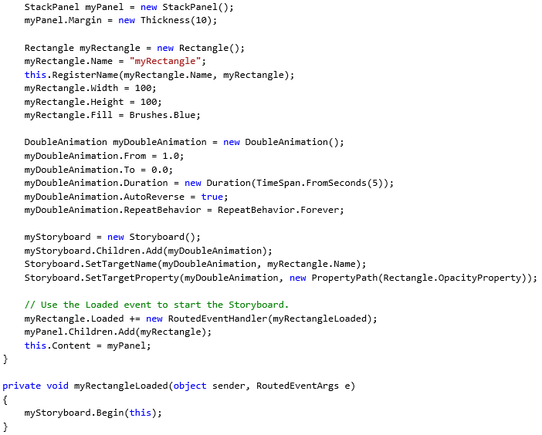
Notes:
Sample hand coding an animation

Slide 6
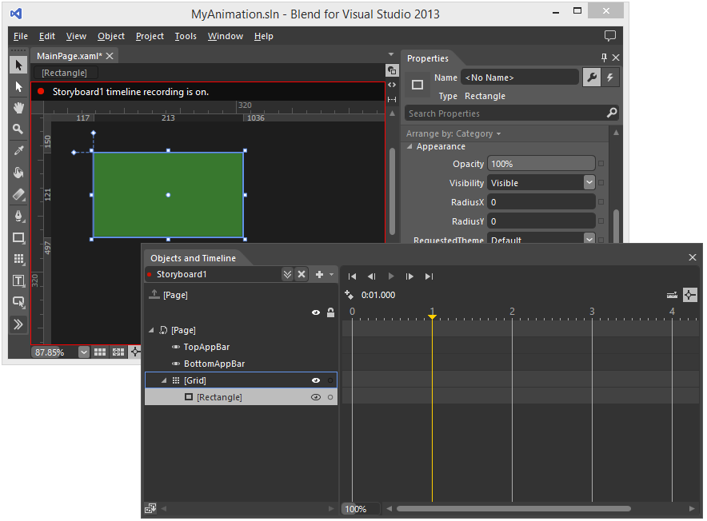
Notes:
Sample animation using Blend.

Slide 7
The Demo
How To:
- Create a custom window shape.
- Creating templates
- Custom button

Slide 8
Blend for Visual Studio 2015
Major changes
- UI
- Extensions/NuGet
- Debugging
- Improved IntelliSense for XAML
- Edited files should update automatically!!
Notes:
- New UI to be consistent with VS to improve workflow – will take some getting use to from the current.
Debugging is currently not available.
Files will update automatically making it easier to collaborate on bigger projects.

Slide 9
Useful Links
wpftutorial.net – Christian Moser
MSDN
Codeplex
Youtube
Notes:
Wpftutorial.net – UX Design to Data binding to working with 3D graphics

